Slide 1


AIRLINE SYSTEM
Presented by:
GROUP E
INSTRUCTOR:
Mr. BHAVIK GANDHI

Slide 2




GROUP MEMBERS
ABISHEAK DHANABAL(C0903766)
ALWIN KANNYAKONIL SCARIA (C0894287)
ASHNA VIJI ALEX(C0901082)
JERIN THENGUMPALLIL THOMAS (C0896235)
KUNCHERIA TOM(C0900973)
PRINCE THOMAS (C0894907)
MOHAMED AFTAB (C0891945)

Slide 3
INTRODUCTION
This project is based on the valuable data of US airlines which includes various flights operators, flown flights, various airports, regarding the number of delays and cancellations.
01
The data serves as a crucial resource for analyzing the performance of airlines and identifying areas for optimization.
02
This database helps to identify the issues associated with existing flight schedule system.
03
We primarily focused on resolving the root causes of delays, cancellations and diversions that cause immense operational cost, time and resource wastage rather than passenger analysis.
04

Slide 4

HOW THE US DOMESTIC AIRLINES WORKS
US domestic airlines operate within a complex system that involves various components and processes to ensure safe and efficient air travel.
They have vast networks connecting major cities, regional airports.
U.S domestic airlines are part of global airline alliances.
US airlines use various pricing strategies, including dynamic pricing based on demand, booking time, and seat availability. They also offer different fare classes with varying levels of service and amenities, such as economy, premium economy, business, and first class.
References:- https://www.bts.gov/ (Bureau of Transportation statistics)

Slide 5
PROBLEMS
Consequences of Departure Delay
Flight Diversion Implications
Aging Aircraft Maintenance
Impact of Climatic Conditions
Inexperienced Pilots and Safety

Slide 6

OPPORTUNITY
Enhancing fuel efficiency and reducing disruptions
Strategic flight scheduling
Maintaining reliable travel
Addressing delayed and cancelled flights
Efficient aircraft assignment
Minimizing losses during cancellations
Addressing aircraft issues

Slide 7
ANALYSIS
By examining the delay and cancellation data, airlines can identify common causes of delays and cancellations.
From this system, the users will be able to schedule flights by checking other flights delay, cancelled and scheduled timing.
Based on the geographical insights and taxi-on off timings, optimized airport selection and taxi timing.
User-friendly experience.
Understand flight cancellations.
Identify airlines with high delay rates.

Slide 8
INSIGHTS
Delay of flight on daily basis
Causes of a flight cancelled
Duration of flight runtime
Airport congestion
Diversion

Slide 9
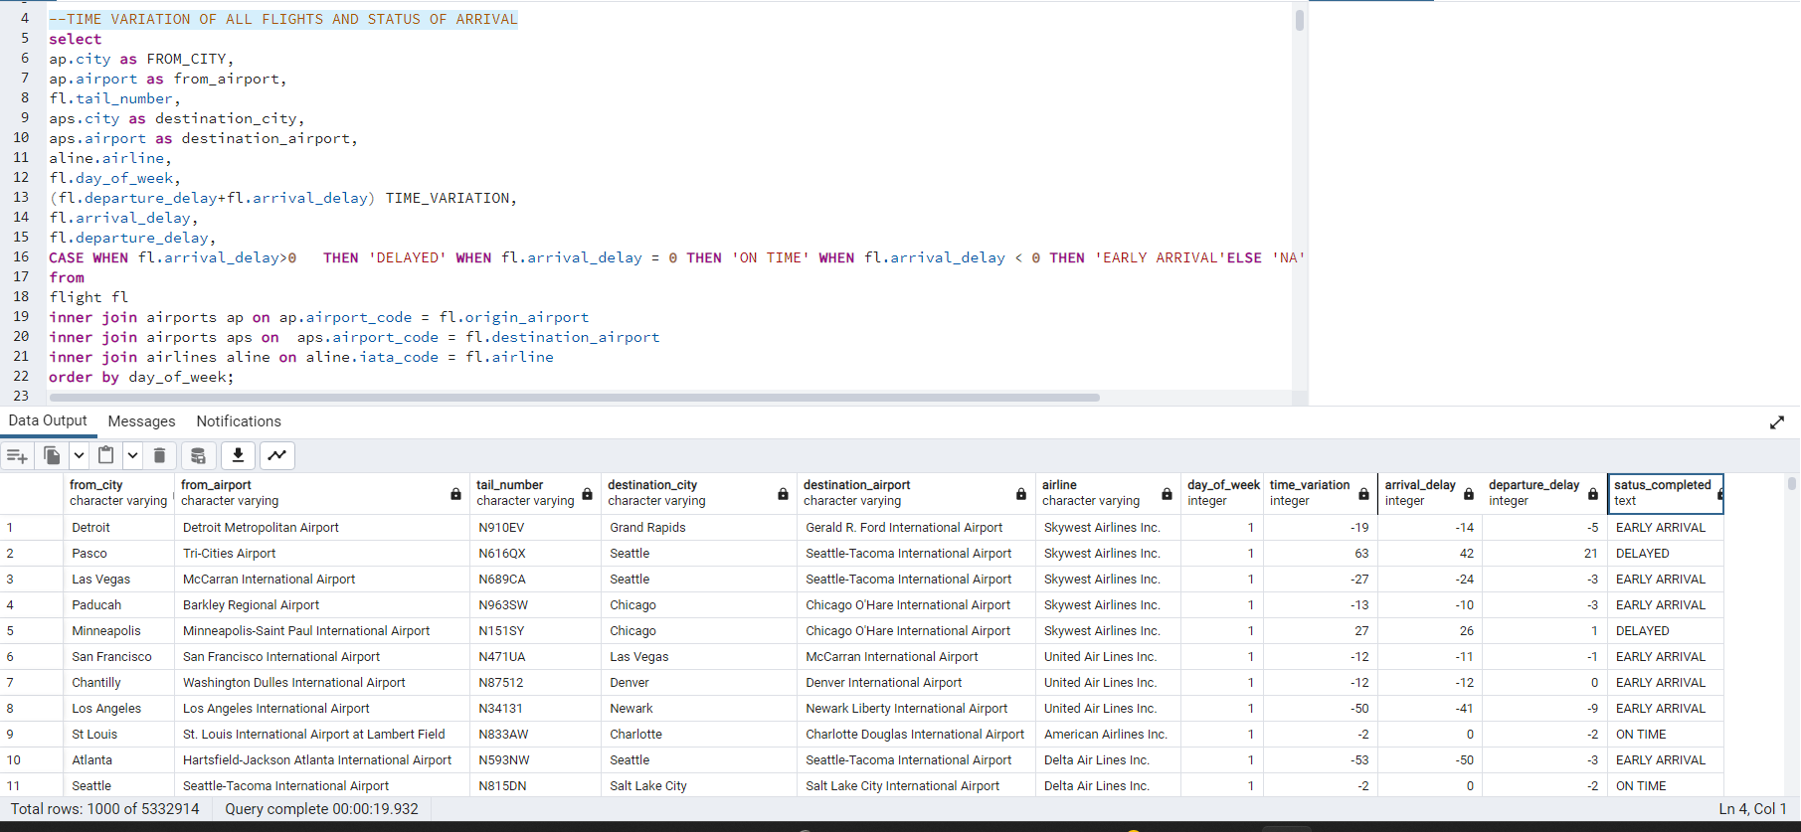
1. TIME VARIATION OF ALL FLIGHTS AND STATUS OF ARRIVAL
SQL CODES
Analyses the general pattern of each flight on its delay by comparing the arrival & destination delays.

Slide 10
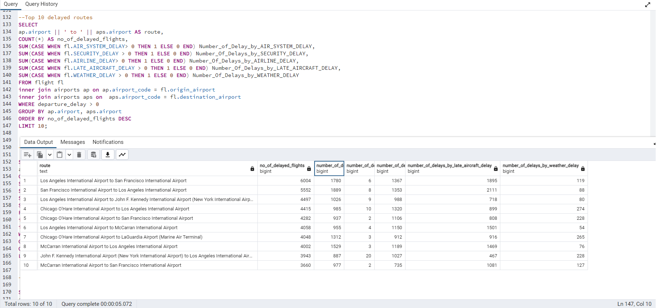
2. TOP 10 DELAYED ROUTES
Checking the highly delayed top 10 routes in U.S

Slide 11
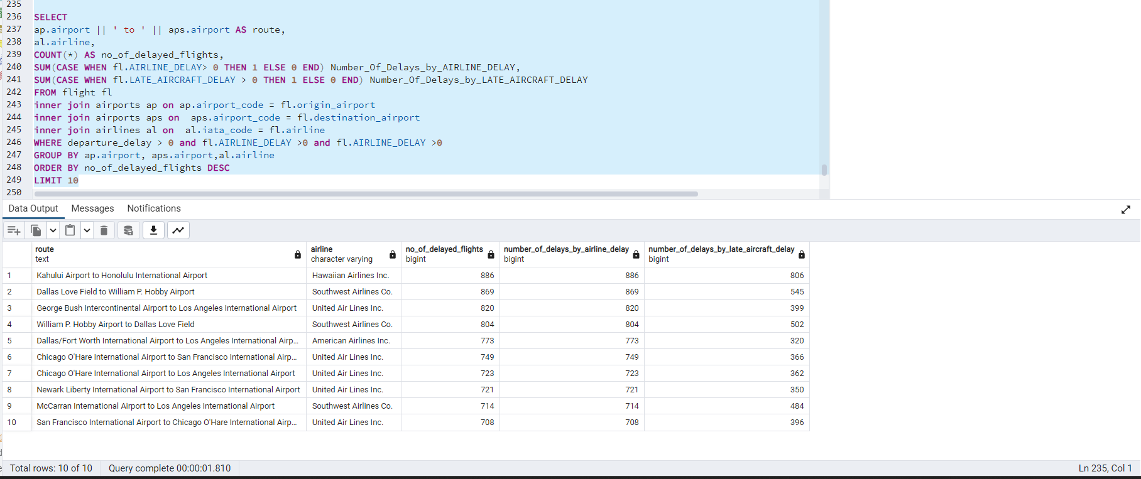
3. TOP 10 DELAYED ROUTES BY AIRCRAFT ISSUES
To find the aircraft which is having high delay rate and top 10 routes which is delayed due to aircraft issues .

Slide 12
HADOOP - MAPREDUCE
Using Hadoop cluster, MapReduce programs were executed which provided insights on:
Average delay of flight on different days of a week
Number of flights and distance travelled based on category of HAUL (flight distance)
Average delay by different airlines

Slide 13
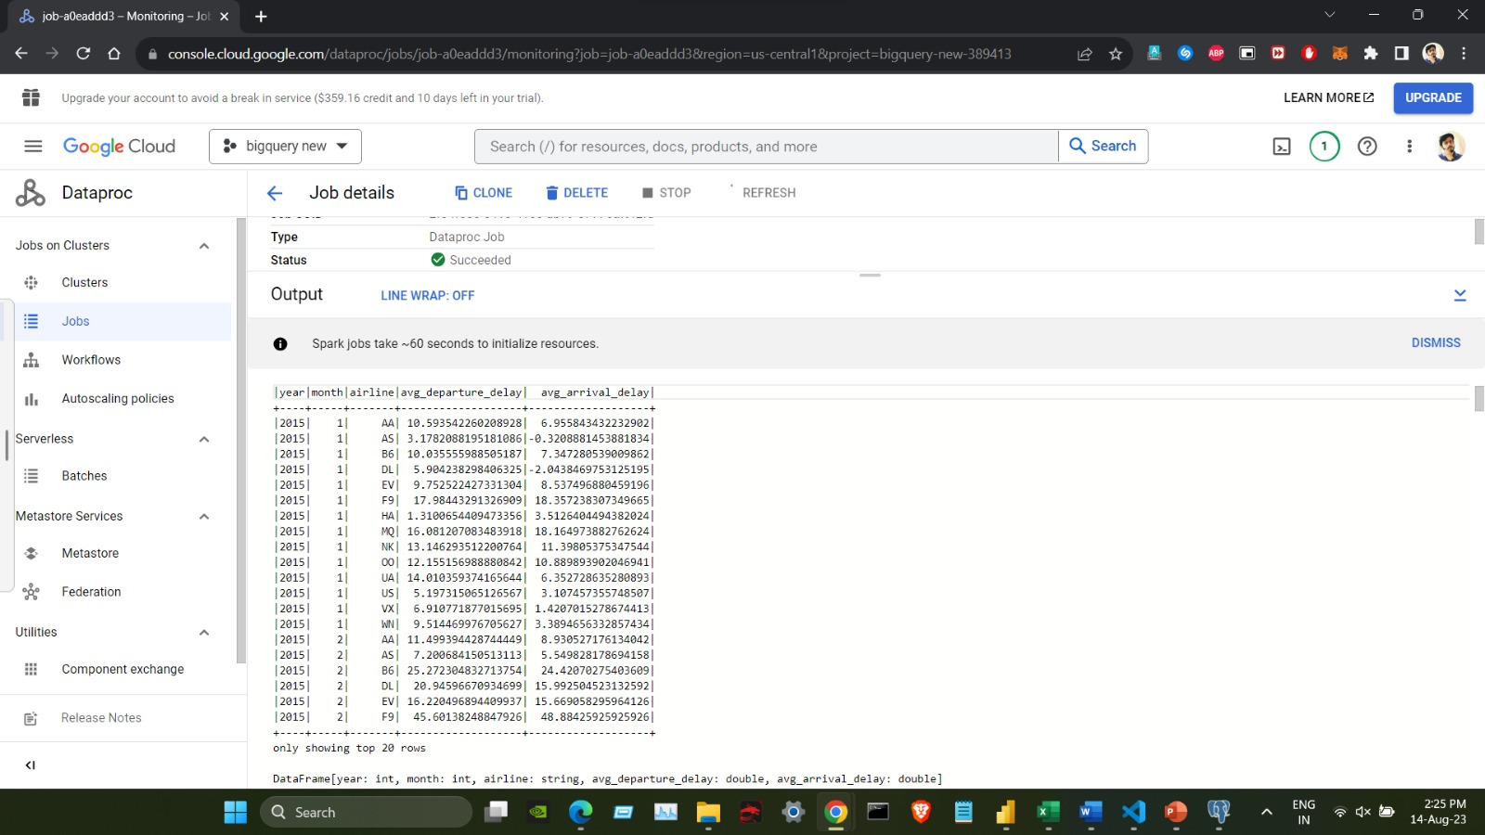
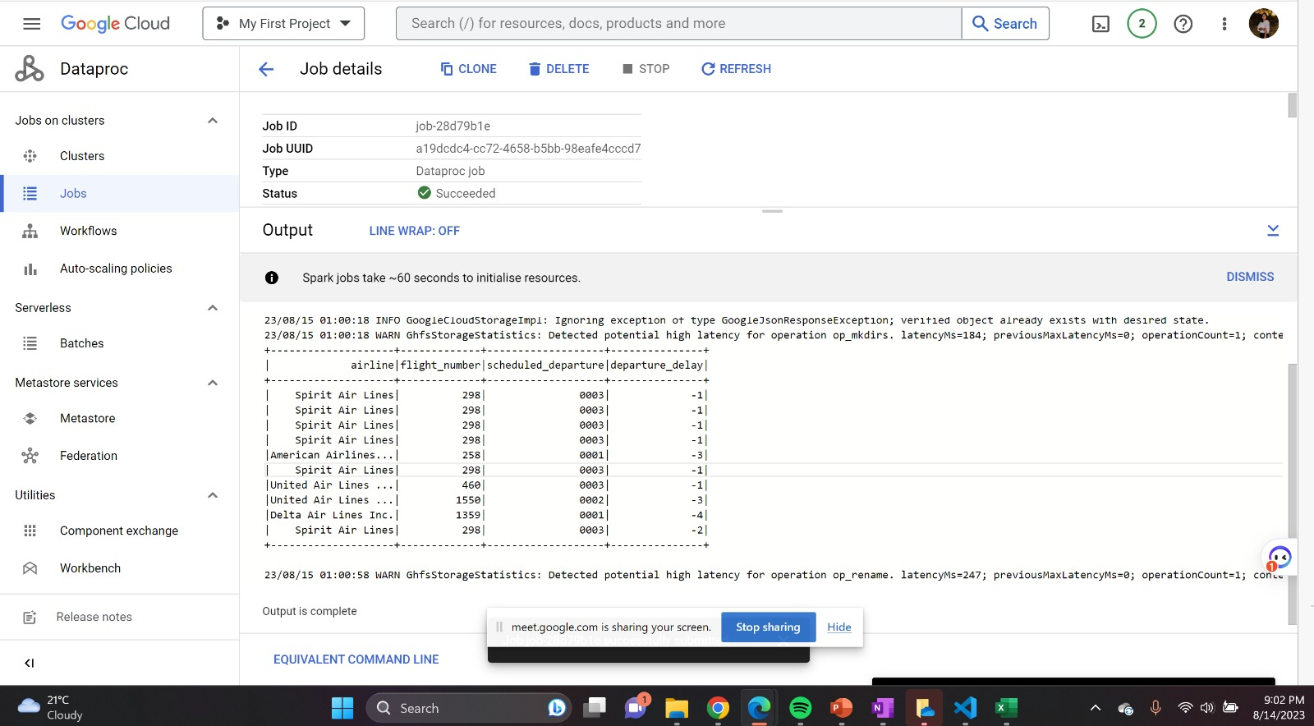
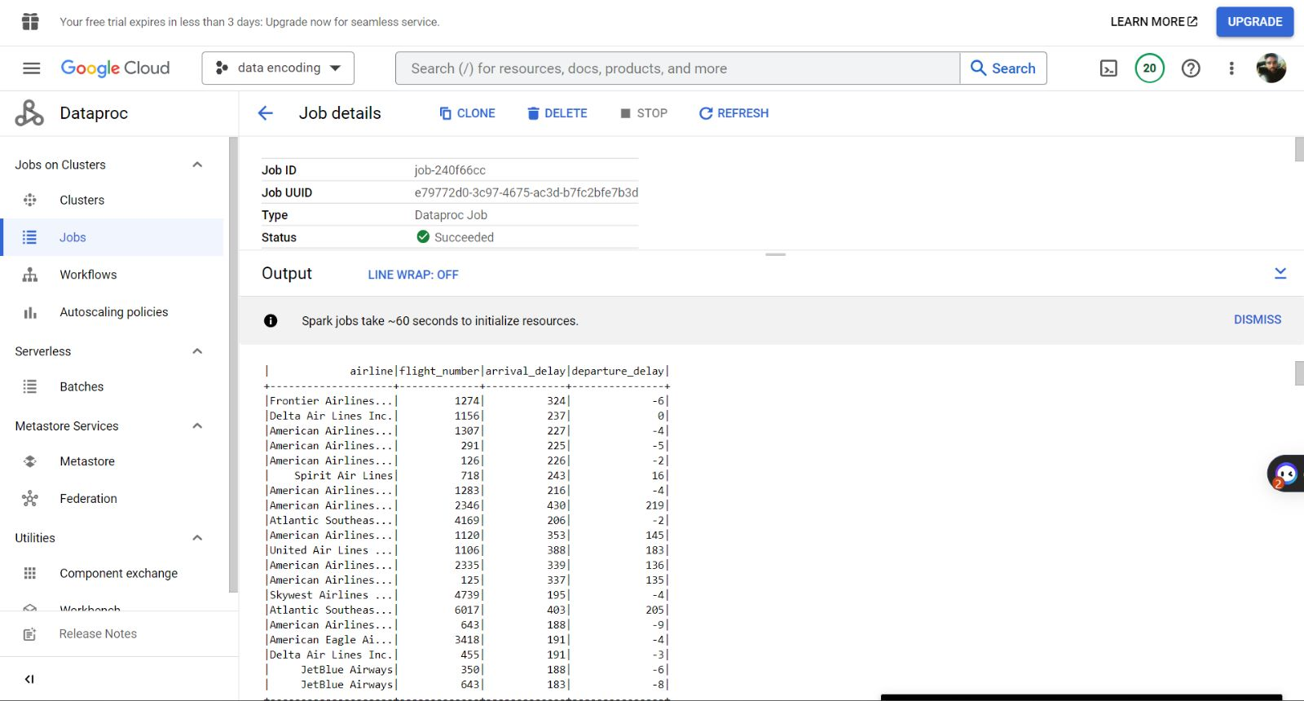
Spark Jobs
Average departure and arrival delays for each airline based on year and month
Flights that departed earlier than their scheduled departure time
Flights with highest arrival delay

Slide 14

VISUALIZATION

Slide 15
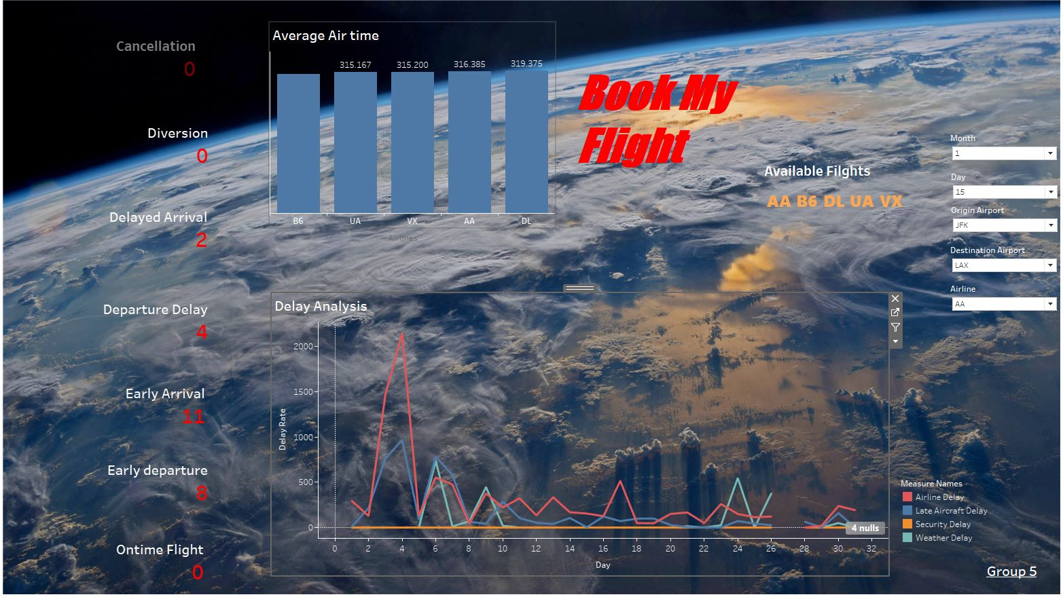
DASHBOARD
Based on the inputs provided by the user, the dashboard updates on the available flights from the origin airport.
Average airtime for each aircraft based on the user mentioned airport is obtained.
The dashboard is dynamic and provides results regarding a flight delay due to airline-delay, late aircraft delay, security delay, weather delay.
The dashboard also provides better understanding of:
how many cancellations was happened to the airline
diversion taken
delayed arrival count, departure delay count, early arrival,
early departure and on time flight is gained.

Slide 16
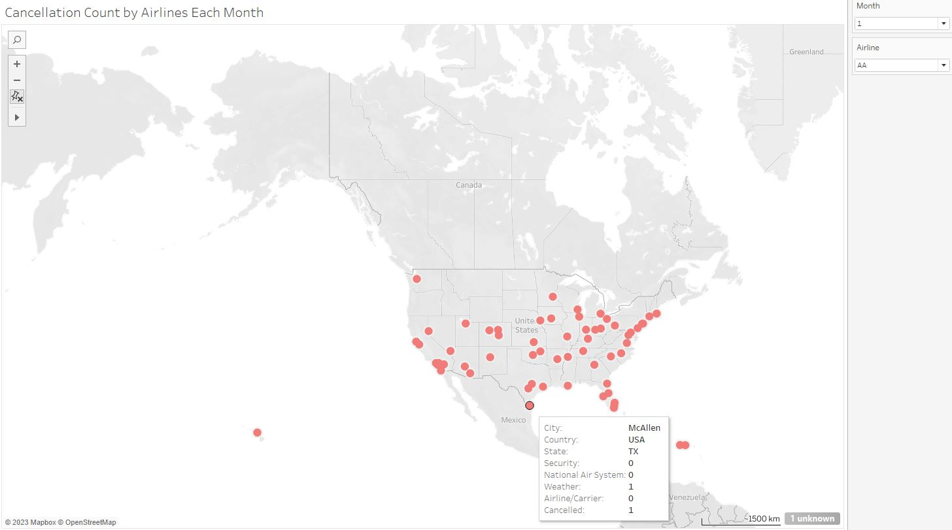
Cancellation count by airlines for each month
This is a geographical analysis which provides understanding about:
the count of airlines which was cancelled due to some specific reasons on a specific month.
Count of cancellation
Place (state, country, city)
Cancellation reason count

Slide 17
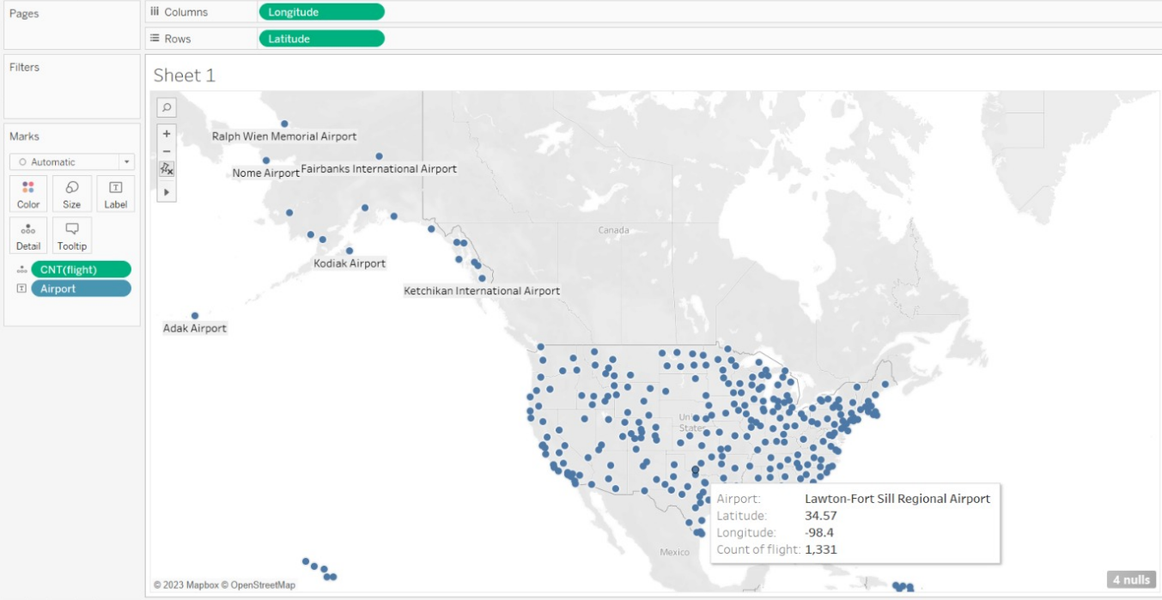
Total number of flights from airports
This is a map visualization which provides understanding about:
the number of flights flown from the origin airports
Latitude
Longitude
Airport

Slide 18
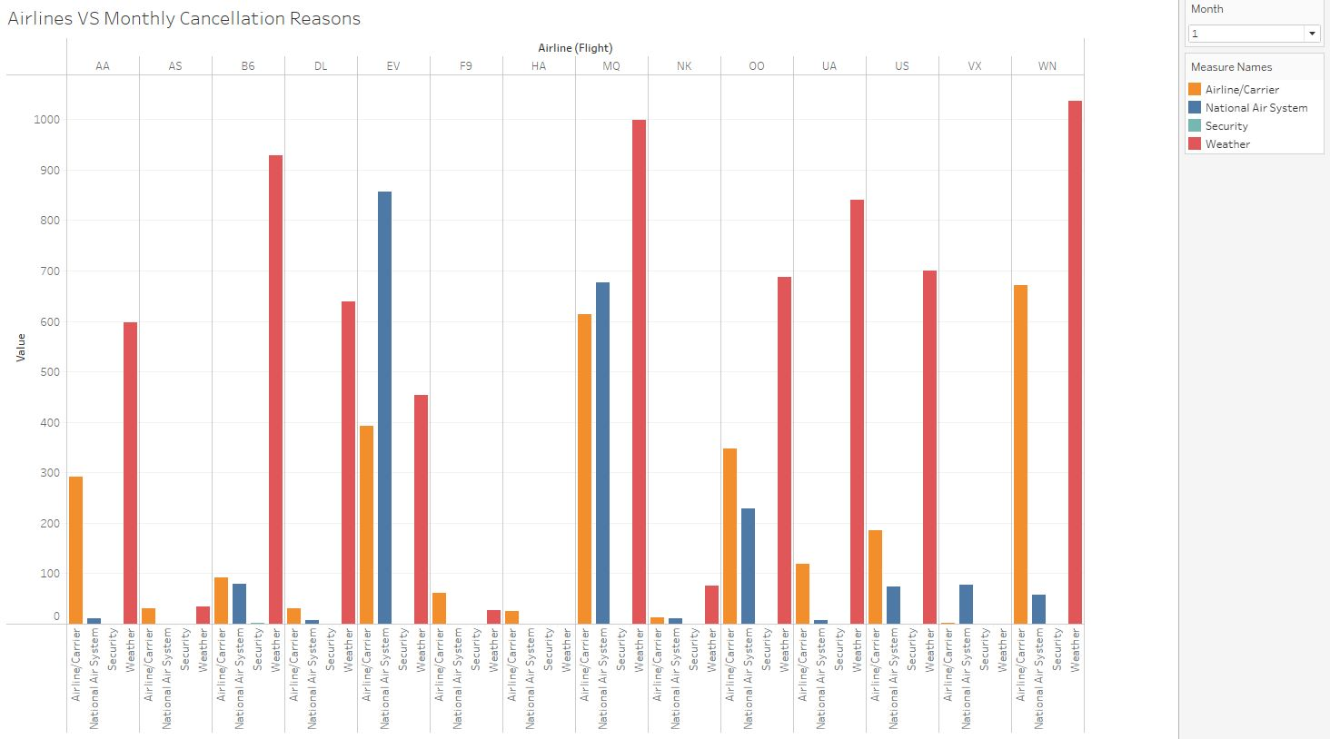
Cancellation count by airlines for each month
This chart helps to understand the cancellation reasons of flights by airlines

Slide 19
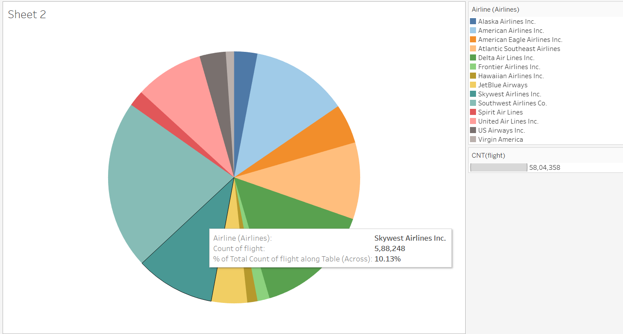
Market Share of various Airlines
This is a pie chart which provides understanding about the market share of various airlines by the number of flights flown by them.

Slide 20
GITHUB REPOSITORY
https://github.com/Jerin-T/airline-analysis

Slide 21
CONCLUSION
On the analysis of the dataset, we found that delay, cancellations, and diversion leads to performance issue in the domestic airlines industry.
We also found a common pattern by airports, airlines and season that are usually delayed.
By identifying the patterns from historic data, we could minimalize the root cause of the issues and enhance the industry performance up to a great extent.
Also, got more hands-on experience in different tools and technologies.

Slide 22
THANK YOU

